Slide 1

The Moment Of Truth..

Slide 2

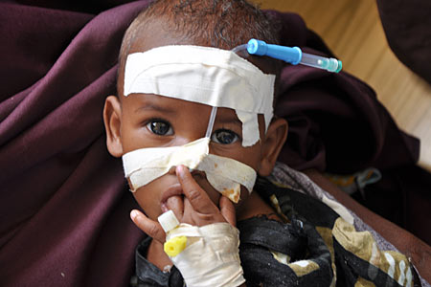
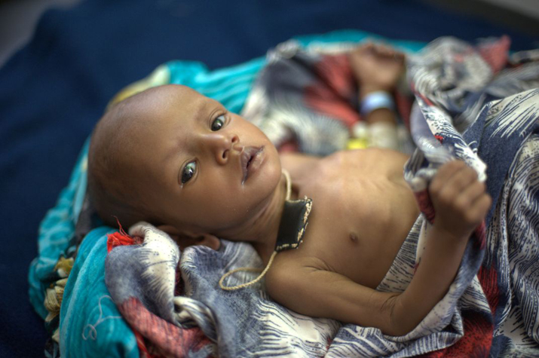
They say, the greatest wealth is health. Then, are these children born poor?

Slide 3

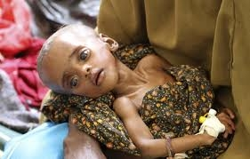
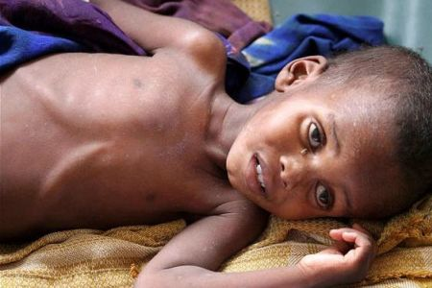
It takes 9 months for a life to come alive, but not even 9 seconds for death to pass by..

Slide 4

Tracing back history..

Slide 5



Limited Resources diminishes child health!

Slide 6


Unawareness everywhere..

Slide 7

Introducing Grow Healthy

Slide 8


‘Grow Healthy’ at a glance..
Aiming at providing round-the-clock service to ensure a prominent standard of child health
Inform readers about facts available to them yet unknown

Slide 9



Getting to know ‘Grow Healthy’..
Provide updated statistics regarding every sector of child health and development.
Help the government to help itself by cutting down on costs previously spent on health facilities for children.

Slide 10


Our Focus: Acquainting the unacquainted!

Slide 11



We have the resources, its time for action!

Slide 12
Let’s get started!

Slide 13

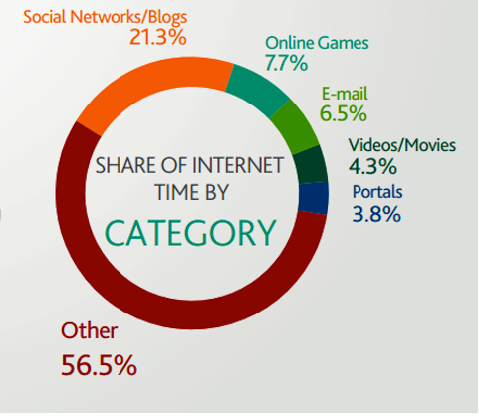
Analyzing time spent on social-networking websites..

Slide 14


Targeting Website Development!

Slide 15



Offering a specialized doctors’ corner:

Slide 16



Let the world know your experiences..
Share your experiences involving your child through a..

Slide 17
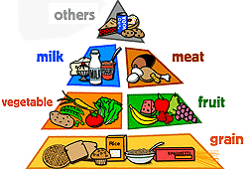

Healthy Nutrition tips?

Slide 18


Statistics aid in taking appropriate action!

Slide 19

Personal Page: store and share precious memories!

Slide 20

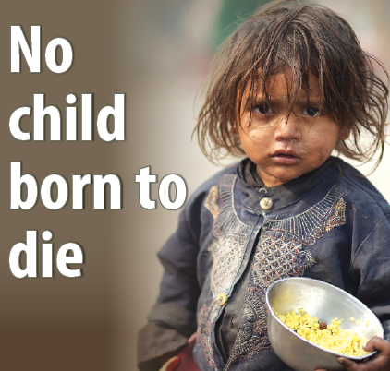
News: Get updated everyday!

Slide 21

Wait! How about people without an access to the Internet? What about their children?

Slide 22


Introducing SMS from SNS(Social Networking Site)!

Slide 23


Alert messages: Reminders-in-time!

Slide 24


Not-to-forget, bridging the communication gap!

Slide 25


How many vaccinations does a child need?
High fever! Emergency tips?

Slide 26
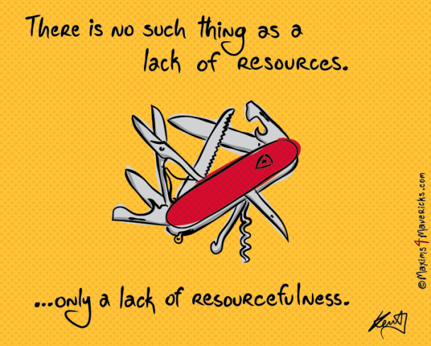
We believe..

Slide 27



Slide 28


Welcoming you!

Slide 29

“There are no seven wonders in the eyes of a child, there are seven million.” We are saving them..

